Slide 2
According
to the
pattern
EXODUS 25:8-9
Part 2

Slide 3
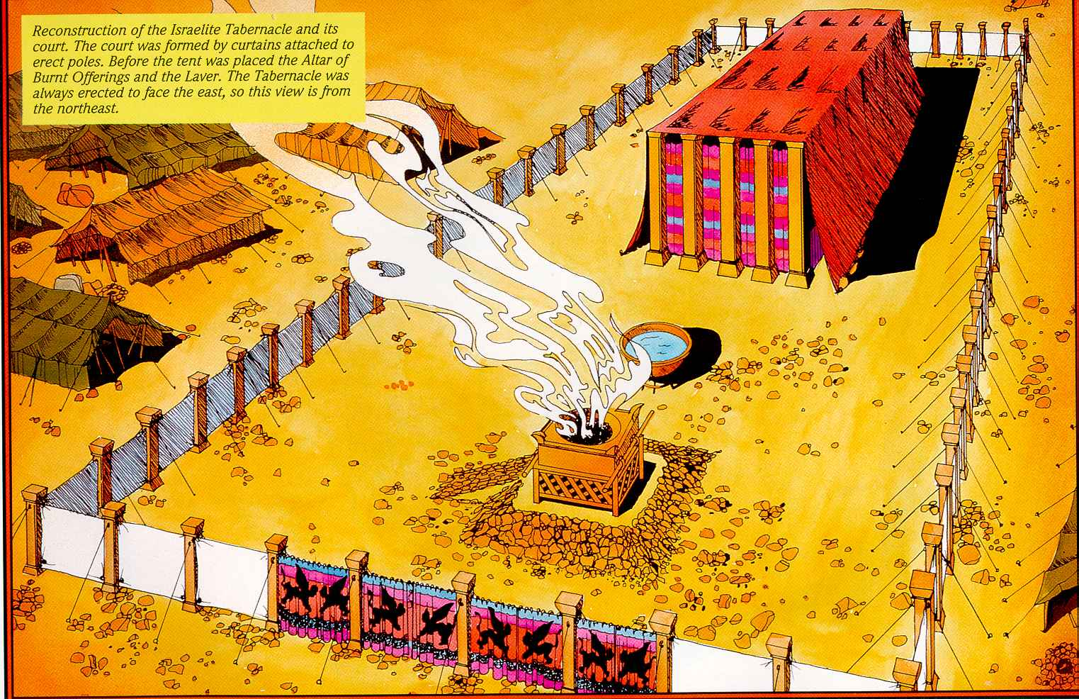

Slide 5
“All this,” said David, “the Lord made me understand in writing by His hand upon me, all the details of this pattern.”
1 Chronicles 28:19 NASB

Slide 6
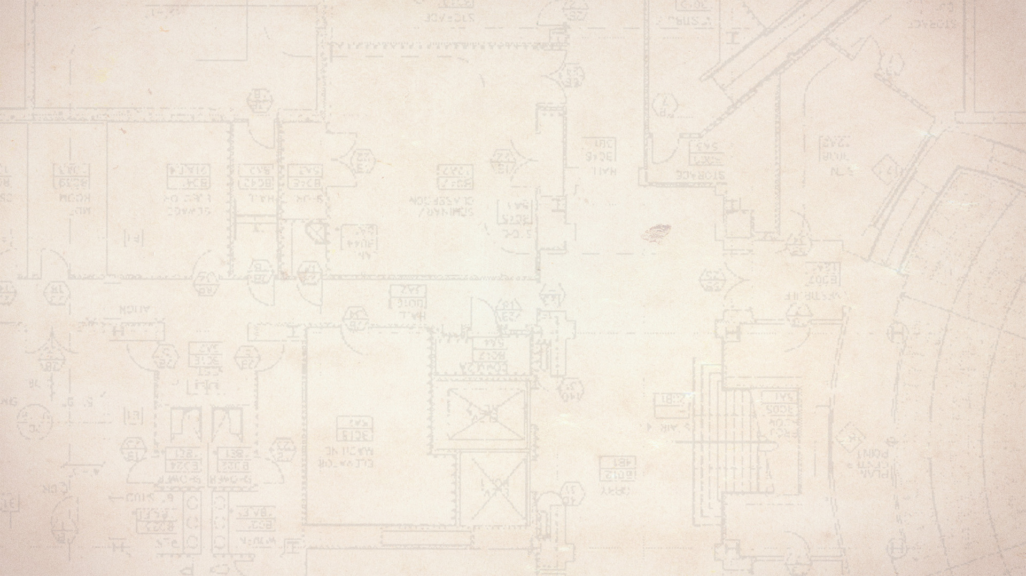
Just as Moses was given a pattern, the church is given one as well.
That pattern must be followed!

Slide 7
Hold fast the pattern of sound words which you have heard from me, in faith and love which are in Christ Jesus. That good thing which was committed to you, keep by the Holy Spirit who dwells in us.
2 Timothy 1:13-14 NASB

Slide 8
THE PATTERN FOR CHURCH ORGANIZATION
Elders:
Role of oversight over a local church.
Multiple elders are to oversee a single church.

Slide 9
The elders who are among you I exhort, I who am a fellow elder and a witness of the sufferings of Christ, and also a partaker of the glory that will be revealed: 2 Shepherd the flock of God which is among you, serving as overseers, not by compulsion but willingly, not for dishonest gain but eagerly; 3 nor as being lords over those entrusted to you, but being examples to the flock.
1 Peter 5:1-3 NASB

Slide 10
THE PATTERN FOR CHURCH ORGANIZATION
Elders:
Role of oversight over a local church.
Multiple elders are to oversee a single church.
Other terms for elders:
Overseers
Bishops

Slide 11
This is a true saying, if a man desire the office of a bishop, he desireth a good work.
1 Timothy 3:1 KJV
It is a trustworthy statement: if any man aspires to the office of overseer, it is a fine work he desires to do.
1 Timothy 3:1 NASB

Slide 12
THE PATTERN FOR CHURCH ORGANIZATION
Elders:
Role of oversight over a local church.
Multiple elders are to oversee a single church.
Other terms for elders:
Overseers
Bishops
Shepherds

Slide 13
And he gave the apostles, the prophets, the evangelists, the shepherds and teachers,…
Ephesians 4:11 ESV

Slide 14
THE PATTERN FOR CHURCH ORGANIZATION
Elders:
Role of oversight over a local church.
Multiple elders are to oversee a single church.
Other terms for elders:
Overseers
Bishops
Shepherds
Pastors

Slide 15
And he gave the apostles, the prophets, the evangelists, the shepherds and teachers,…
Ephesians 4:11 ESV
And He gave some as apostles, and some as prophets, and some as evangelists, and some as pastors and teachers,…
Ephesians 4:11 NASB

Slide 16
THE PATTERN FOR CHURCH ORGANIZATION
Elders:
Preachers are not called pastors in the Bible.

Slide 17
And He gave some as apostles, and some as prophets, and some as evangelists, and some as pastors and teachers,…
Ephesians 4:11 NASB

Slide 18
But you, be sober in all things, endure hardship, do the work of an evangelist, fulfill your ministry.
2 Timothy 4:5 NASB

Slide 19
THE PATTERN FOR CHURCH ORGANIZATION
Elders:
Preachers are not called pastors in the Bible.
Elders have specific qualifications to meet.

Slide 20
THE PATTERN FOR CHURCH ORGANIZATION
Deacons:
A special position of service.
They also must meet specific qualifications.
No female “deaconess” position.
Deacons serve in a local church together with elders.

Slide 21
Paul and Timothy, bond-servants of Christ Jesus,
To all the saints in Christ Jesus who are in Philippi, including the overseers and deacons:…
Philippians 1:1 NASB

Slide 22
THE PATTERN FOR CHURCH ORGANIZATION
Local church autonomy:
Each local church in the N.T. was independent and self-governing.
Not controlled by a headquarters or another church.
Each church received the same teaching in Christ.

Slide 23
For this reason I have sent to you Timothy, who is my beloved and faithful child in the Lord, and he will remind you of my ways which are in Christ, just as I teach everywhere in every church.
1 Corinthians 4:17 NASB

Slide 24
THE PATTERN FOR CHURCH ORGANIZATION
The N.T. knows nothing of modern manmade methods of church organization.

Slide 25
According
to the
pattern
EXODUS 25:8-9

